Slide 1
The Life Is Great Eatery
By: The Snazzy Software Squad
Jeremy Cruz
Chiara DeMelfi
Ashlyn Welch
Lauren Turet
Felix Thomas

Slide 2
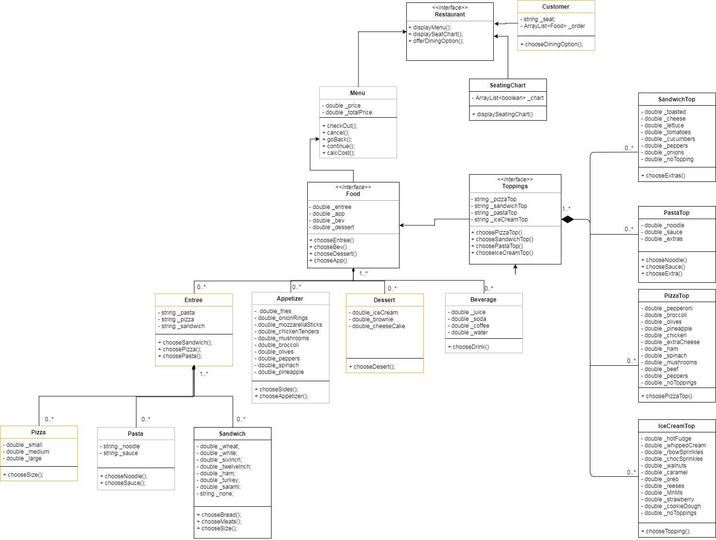
UML Class Diagram

Slide 3
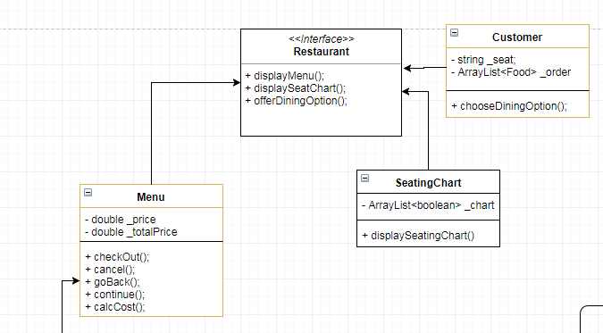
UML Class Diagram (let’s zoom in!)

Slide 4
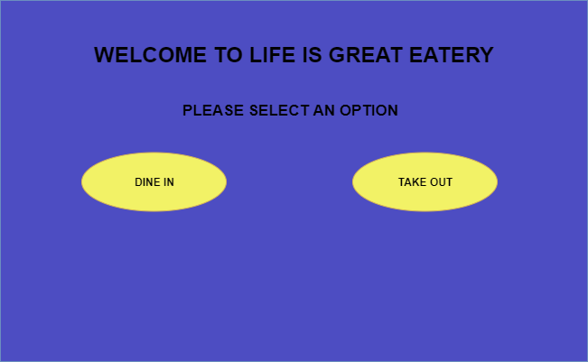

Slide 5
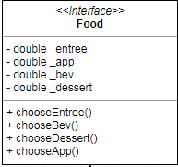
Food

Slide 6
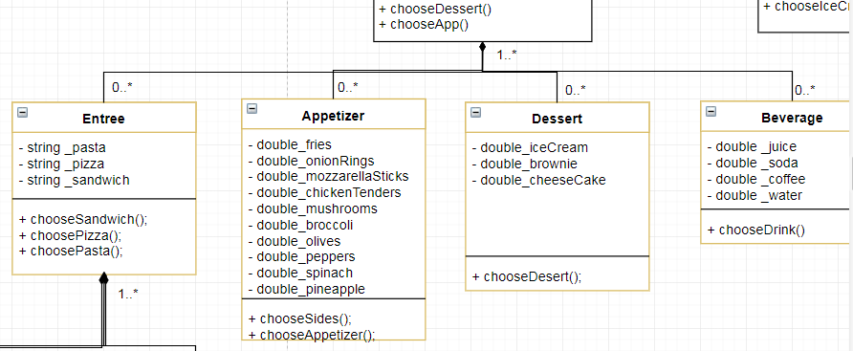
Food Categories and Beverages

Slide 7
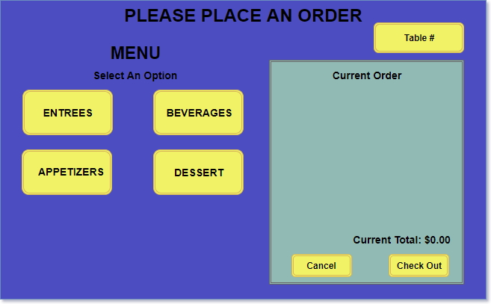

Slide 8
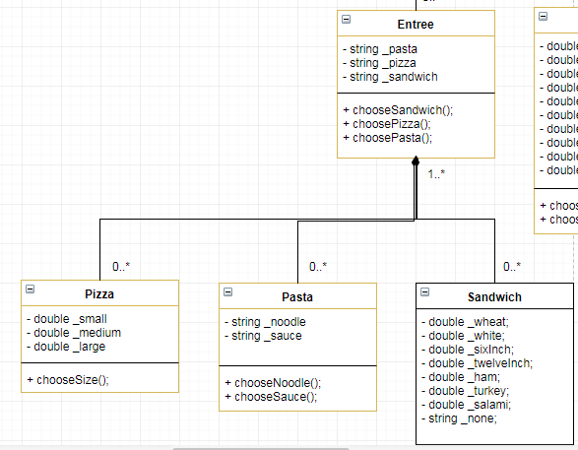
Food and Beverage Options

Slide 9
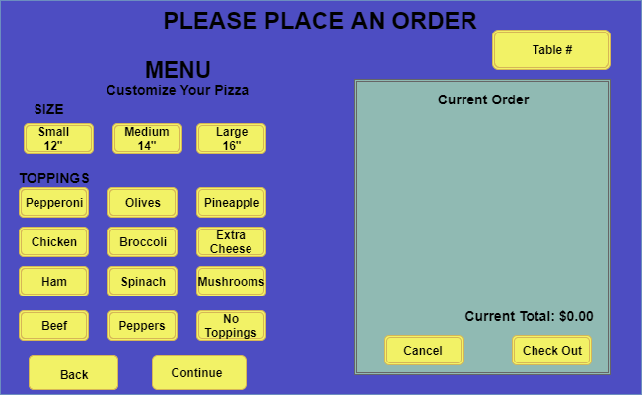

Slide 10
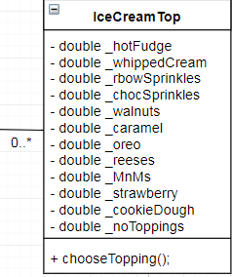
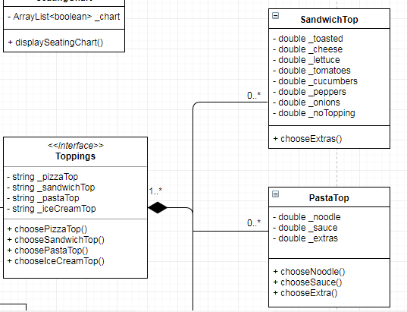
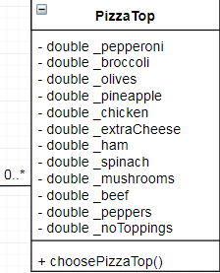
Toppings

Slide 11
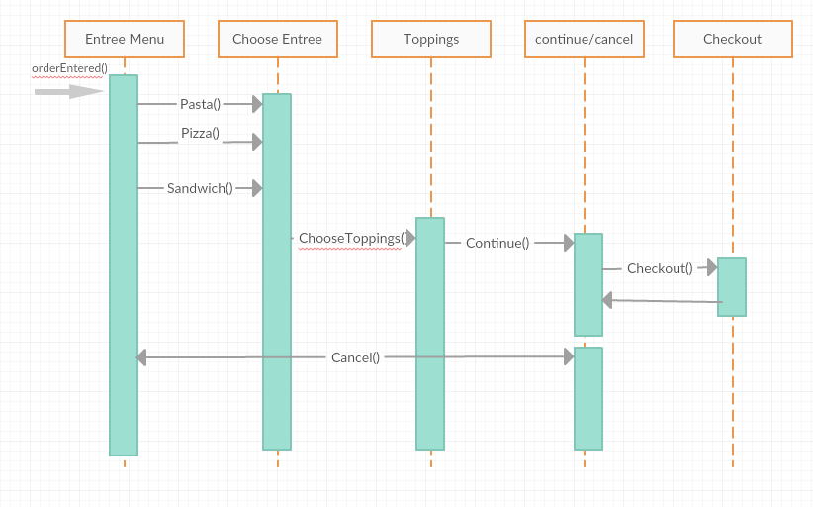
Ordering Entree Sequence Diagram

Slide 12
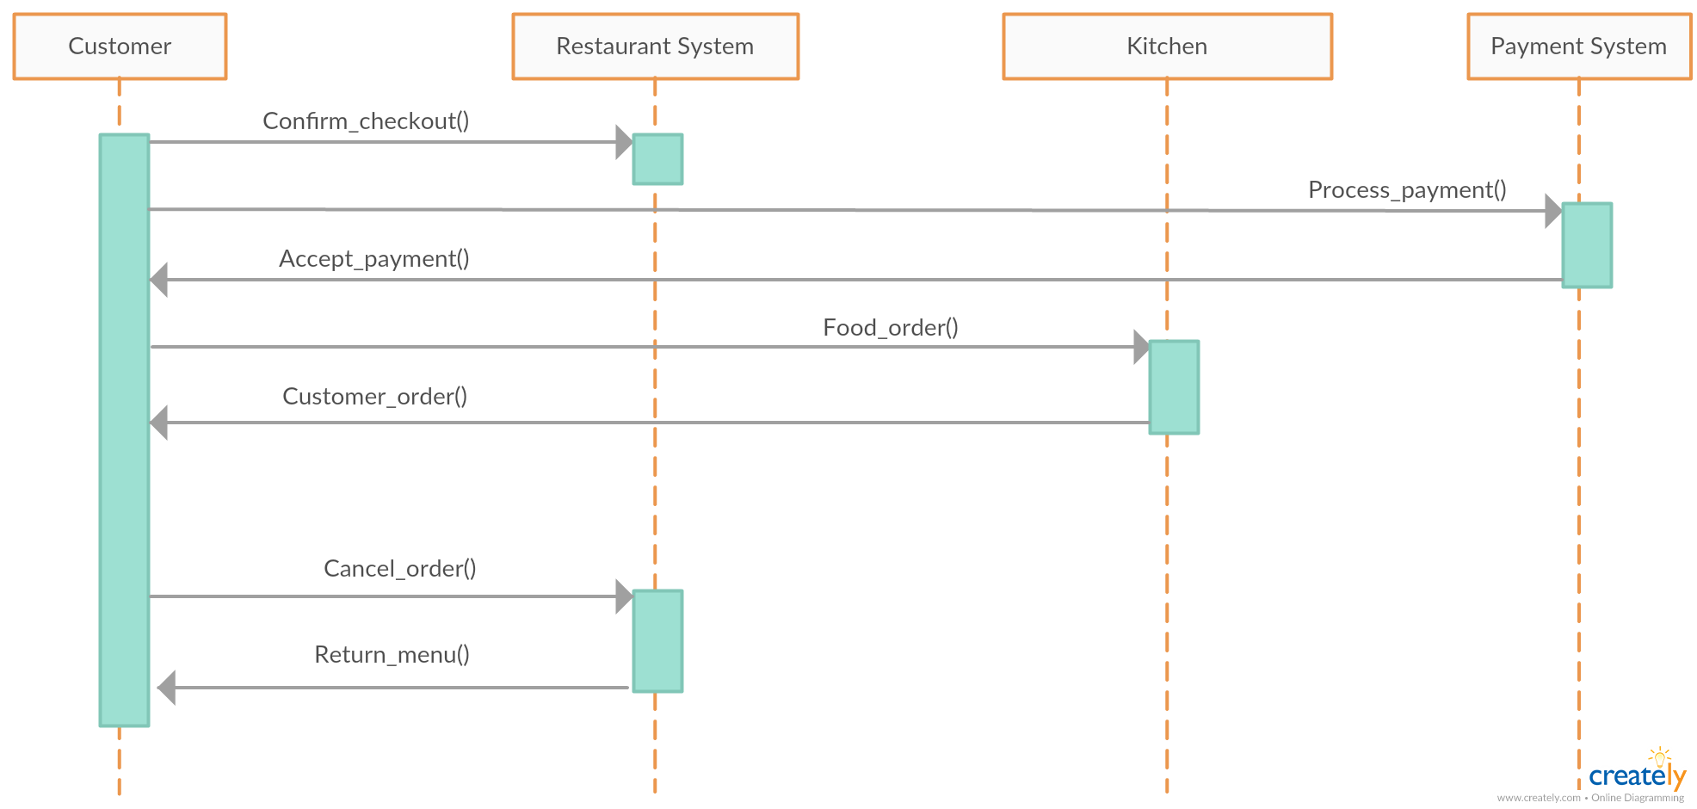
Ordering Process Sequence Diagram

